Slide 1
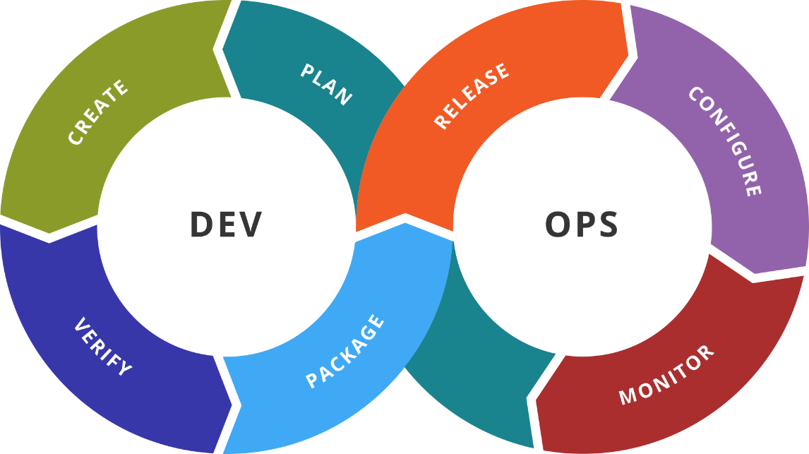
Introduction to Docker
Install Docker. Work with Images & Containers
SoftUni Team
Technical Trainers
Software University
https://softuni.bg

Slide 2
You Have Questions?
sli.do
#DevOps-23
facebook.com
/groups/DevOpsContainerizationCICDMonitoringJanuary2023

Slide 3
Homework Progress
Solutions for M1
can be submitted
until 23:59 on 06.02.2023
Solutions for M2
can be submitted
until 23:59 on 13.02.2023

Slide 4

Previous Module (M1)
Quick Overview

Slide 5
What We Covered
The Big Picture
Main Pain Points and Causes
Goals and Benefits
Adoption and Tools
Basic Toolkit
Basic Automation

Slide 6

Dev
Ops
This Module (M2)
Topics and Lab Infrastructure

Slide 7
Table of Contents
Containerization
Introduction to Docker
Docker in Action
Create Our Own Images

Slide 8
Lab Infrastructure
2-nd NETWORK: Internal (or private/host-only) Network
Int
.100
.200
DOCKER
(CentOS)
DOCKER
(Debian)
We will create just one of them. Pick the one you prefer
OS
OS
NAT
1-st NETWORK: NAT Adapter (with port forwarding for easier management)
VirtualBox / VMware / Hyper-V
vagrant
Windows / Linux / macOS

Slide 9
Dev
Ops
Containers and Docker
Past. Present. Future

Slide 10
Containerization
“
OS-level virtualization refers to an operating system paradigm in which the kernel allows the existence of multiple isolated user space instances known as containers, zones, jails, …
”
https://en.wikipedia.org/wiki/OS-level_virtualization

Slide 11
Road to Containers
Companies and Solutions
2004
Solaris Containers
(zones)
2011
Warden
By CloudFoundry
2000 - 2001
1) FreeBSD Jails
2) Virtuozzo
3) Linux VServer
2005
Virtuozzo OpenVZ
2007
HP-UX Containers
IBM WPAR
2013
Docker
By Docker Inc
2014
Rkt
By CoreOS
1979
chroot
1999
1) Capabilities
2) AppArmor
3) SELinux
2002
Mount Namespaces
2006
1) Process Containers (cgroups) by Google
2) UTS and IPC Namespaces
2008
1) cgroups in kernel
2) PID and Network Namespaces
3) User Namespace
4) LXC
Enablement Technologies

Slide 12
Container Types and Solutions
System Containers (BSD Jails, Solaris Zones, …)
LXC + LXD + LXCF by Canonical
Container hypervisor (system containers)
https://linuxcontainers.org/
Application Containers (containerd, CRI-O, …)
Docker by Docker Inc
Tools and application container engine
https://www.docker.com/
OS-centric
Multiple processes
App-centric
Single process *

Slide 13
VMs vs Containers
VMs virtualize the hardware
Complete isolation
Complete OS installation. Requires more resources
Runs almost any OS
Containers virtualize the OS
Lightweight isolation
Shared kernel. Requires fewer resources
Runs on the same OS
…

Slide 14
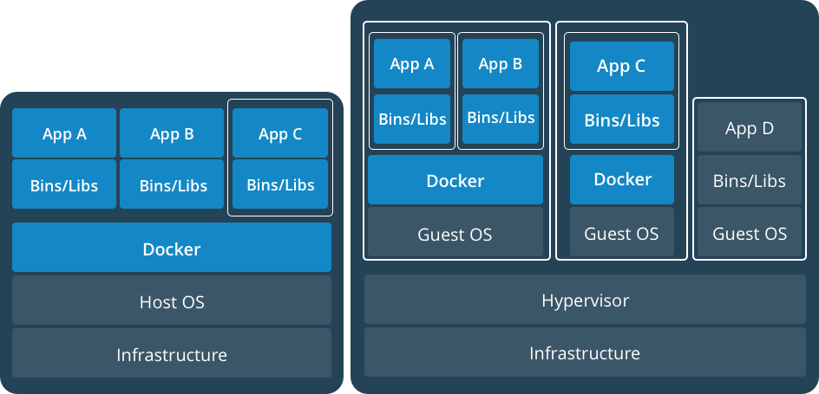
Together: VMs and Containers
https://www.docker.com/what-container

Slide 15
Dev
Ops
Docker
Whole New World

Slide 16
Containers Concepts (Docker View)
Container host is a physical or virtual computer system configured with a container engine
Container image shows the state of a container, including registry or file system changes
Container OS image is the first layer of potentially many image layers that make up a container
Container repository stores container images and their dependencies

Slide 17
Definitions
Container
A runnable instance of an image. Containers are processes with much more isolation
Image
A read-only template of a container built from layers. Images provide a way for simpler software distribution
Repository
A collection of different versions of an image identified by tags
Registry
A collection of repositories
Writable Layer
A1
/file1
BB
/file2
Volume
MariaDB
BB
/file2
Layers
Ubuntu
A1
/file1
bb
/file2
Container

Slide 18
Image Layers
L4
Writable
merge
L3
L2
Read Only
L1

Slide 19
Docker Platform
Client Station #1
Docker Client
(docker)
**
Docker Host
Registry
(Docker Hub)
Docker Client *
**
Docker API
**
Docker Daemon (dockerd)
Client Station #n
**
Container Runtime
(containerd)
Docker Client
(docker)
Docker Client
(docker-compose)
* Not required, but we could install it there as well
** TCP or UNIX socket

Slide 20
Workflow
Client Station
Docker Host
docker pull
Docker Daemon
Registry
IMG
A
docker run
Containers
Images
CO
B
IMG
A
IMG
B
docker build
CO
A
IMG
B
IMG
C
docker push
IMG
D
IMG
D

Slide 21
Installation Options
Docker Desktop
Linux
macOS
Windows
Docker Engine
Various Linux distributions
Various hardware architectures
Specific requirements: OS version, Hypervisor, etc.
Deployment via package system (two channels – stable, and test), script, or archive
x86_64/amd64
arm64 (aarch64)
arm (armhf)
s390x
https://docs.docker.com/engine/install/

Slide 22
Registries
Provided by Docker
Cloud
Docker Hub (https://hub.docker.com/explore/)
On-premise
Standalone
Containerized
Provided by 3rd parties
Quay.io, Artifactory, Google Container Registry, etc.
Registries can be private or public
Repositories can also be private or public

Slide 23
Dev
Ops
Practice: Installation & Hello World
Live Demonstration in Class

Slide 24
Dev
Ops
Working with Docker
Commands

Slide 25
Command Specifics
Syntax varies amongst versions
Old (short) style – still available
New style – preferred
Grouped by target
Management Commands
General Commands

Slide 26
search
Purpose
Search the Docker Hub for images
Old (short) syntax
New syntax
Example (search for image that have ubuntu in their name)
docker search [OPTIONS] TERM
# same
docker search ubuntu

Slide 27
pull / image pull
Purpose
Pull an image or a repository from a registry
Old (short) syntax
New syntax
Example (download the ubuntu:latest image locally)
docker pull [OPTIONS] NAME[:TAG|@DIGEST]
docker image pull [OPTIONS] NAME[:TAG|@DIGEST]
docker image pull ubuntu:latest

Slide 28
run / container run
Purpose
Run a command in a new container
Old (short) syntax
New syntax
Example (run bash in ubuntu based container interactively)
docker run [OPTIONS] IMAGE [COMMAND] [ARG]
docker container run [OPTIONS] IMAGE [COMMAND] [ARG]
docker container run -it ubuntu bash

Slide 29
images / image ls
Purpose
List locally available images
Old (short) syntax
New syntax
Example (list all tags for the fedora image)
docker images [OPTIONS] [REPOSITORY[:TAG]]
docker image ls [OPTIONS] [REPOSITORY[:TAG]]
docker image ls fedora

Slide 30
ps / container ls
Purpose
List containers
Old (short) syntax
New syntax
Example (return running and stopped container IDs)
docker ps [OPTIONS]
docker container ls [OPTIONS]
docker container ls -a -q

Slide 31
rm / container rm
Purpose
Remove one or more containers
Old (short) syntax
New syntax
Example (remove container by its name)
docker rm [OPTIONS] CONTAINER [CONTAINER]
docker container rm [OPTIONS] CONTAINER [CONTAINER]
docker container rm weezy_snake

Slide 32
rmi / image rm
Purpose
Remove one or more images
Old (short) syntax
New syntax
Example (remove the ubuntu and fedora images)
docker rmi [OPTIONS] IMAGE [IMAGE]
docker image rm [OPTIONS] IMAGE [IMAGE]
docker image rm ubuntu fedora

Slide 33
create / container create
Purpose
Create a new container
Old (short) syntax
New syntax
Example (create a container without starting it)
docker create [OPTIONS] IMAGE [COMMAND] [ARG]
docker container create [OPTIONS] IMAGE [COMMAND] [ARG]
docker container create -t -i fedora bash

Slide 34
rename / container rename
Purpose
Rename a container
Old (short) syntax
New syntax
Example (change container name from cont1 to newcont1)
docker rename CONTAINER NEW_NAME
docker container rename CONTAINER NEW_NAME
docker container rename cont1 newcont1

Slide 35
kill / container kill
Purpose
Kill one or more running containers
Old (short) syntax
New syntax
Example (stop a container by its ID)
docker kill [OPTIONS] CONTAINER [CONTAINER]
docker container kill [OPTIONS] CONTAINER [CONTAINER]
docker container kill 0cbf27183

Slide 36
start / container start
Purpose
Start one or more stopped containers
Old (short) syntax
New syntax
Example (start a container by its ID and attach to it)
docker start [OPTIONS] CONTAINER [CONTAINER]
docker container start [OPTIONS] CONTAINER [CONTAINER]
docker container start -a -i 0cbf27183

Slide 37
restart / container restart
Purpose
Restart a one or more containers
Old (short) syntax
New syntax
Example (restart a container by its ID)
docker restart [OPTIONS] CONTAINER [CONTAINER]
docker container restart [OPTIONS] CONTAINER [CONTAINER]
docker container restart 0cbf27183

Slide 38
stop / container stop
Purpose
Stop one or more running containers
Old (short) syntax
New syntax
Example (stop a container by its ID)
docker stop [OPTIONS] CONTAINER [CONTAINER]
docker container stop [OPTIONS] CONTAINER [CONTAINER]
docker container stop 0cbf27183

Slide 39
pause / container pause
Purpose
Pause all processes within one or more containers
Old (short) syntax
New syntax
Example (pause a container by its ID)
docker pause CONTAINER [CONTAINER]
docker container pause CONTAINER [CONTAINER]
docker container pause 0cbf27183

Slide 40
unpause / container unpause
Purpose
Resume all processes within one or more containers
Old (short) syntax
New syntax
Example (resume a container by its ID)
docker unpause CONTAINER [CONTAINER]
docker container unpause CONTAINER [CONTAINER]
docker container unpause 0cbf27183

Slide 41
attach / container attach
Purpose
Attach to a running container
Old (short) syntax
New syntax
Example (attach to the process in a container by its ID)
docker attach [OPTIONS] CONTAINER
docker container attach [OPTIONS] CONTAINER
docker container attach 0cbf27183

Slide 42
tag / image tag
Purpose
Tag an image into a repository
Old (short) syntax
New syntax
Example (create a new tag for an existing image)
docker tag SOURCE_IMAGE[:TAG] TARGET_IMAGE[:TAG]
docker image tag SOURCE_IMAGE[:TAG] TARGET_IMAGE[:TAG]
docker image tag test:1.0 repo-name/test:latest

Slide 43
push / image push
Purpose
Push an image or repository to a registry
Old (short) syntax
New syntax
Example (publish a local image to a remote registry)
docker push [OPTIONS] NAME[:TAG]
docker image push [OPTIONS] NAME[:TAG]
docker image push repo-name/test:latest

Slide 44
login
Purpose
Log into a Docker registry
Old (short) syntax
New syntax
Example (authenticate against a custom registry)
docker login [OPTIONS] [SERVER]
# same
docker login localrepo:5000

Slide 45
logout
Purpose
Log out from a Docker registry
Old (short) syntax
New syntax
Example (log out from a custom registry)
docker logout [OPTIONS] [SERVER]
# same
docker logout localrepo:5000

Slide 46
export / container export
Purpose
Export a container's filesystem as a tar archive
Old (short) syntax
New syntax
Example (export container's filesystem as a file)
docker export [OPTIONS] CONTAINER
docker container export [OPTIONS] CONTAINER
docker container export -o file.tar test

Slide 47
import / image import
Purpose
Import the contents from a tar to create a filesystem image
Old (short) syntax
New syntax
Example (import the file.tar as a new-test container image)
docker import [OPTIONS] file|URL|- [REPOSITORY[:TAG]]
docker image import [OPTIONS] file|URL|- [REPOSITORY[:TAG]]
docker image import file.tar new-test

Slide 48
save / image save
Purpose
Save one or more images to a tar archive or STDOUT
Old (short) syntax
New syntax
Example (export the busybox image as a file)
docker save [OPTIONS] IMAGE [IMAGE]
docker image save [OPTIONS] IMAGE [IMAGE]
docker image save -o busybox.tar busybox

Slide 49
load / image load
Purpose
Load an image from a tar archive or STDIN
Old (short) syntax
New syntax
Example (import an image from a tar archive file)
docker load [OPTIONS]
docker image load [OPTIONS]
docker image load -i busybox.tar

Slide 50
Dev
Ops
Practice: Working with Containers
Live Demonstration in Class

Slide 51
Dev
Ops
Image from Container

Slide 52
Introduction
Commit a container's file changes to a new image
Use running or stopped container
If running, all processes are paused
Mounted volumes' data is not included
It is advisable to use Dockerfile instead

Slide 53
commit / container commit
Purpose
Create a new image from a container’s changes
Old (short) syntax
New syntax
Example (commit a container by its ID and create an image)
docker commit [OPTIONS] CONTAINER [REPOSITORY[:TAG]]
docker container commit [OPTIONS] CONTAINER [REPOSITORY[:TAG]]
docker container commit 0cf23a31 new-cont

Slide 54
Dev
Ops
Image from File
General Structure and Common Fields

Slide 55
General Structure (Dockerfile)
Script, composed of commands and arguments
Always begins with FROM instruction
Comment
# Set the base image
FROM nginx
# Set the maintainer
MAINTAINER John Smith
# Copy files
COPY index.html /usr/share/nginx/html/
Command
(Instruction)
https://docs.docker.com/engine/reference/builder/

Slide 56
FROM
Purpose
Defines the base image to use to start the build process
Syntax
Example
FROM <image>[:<tag>] [AS <name>]
# it is a good practice to state a version (tag)
FROM ubuntu:18.04
# for the latest version, the tag could be skipped
FROM ubuntu
https://docs.docker.com/engine/reference/builder/#from

Slide 57
MAINTAINER
Purpose
Sets the author field of the image. It is deprecated
Syntax
Example
MAINTAINER <name>
# deprecated
MAINTAINER John Smith
# newer variant is this:
LABEL maintainer="John Smith"
https://docs.docker.com/engine/reference/builder/#maintainer-deprecated

Slide 58
LABEL
Purpose
Adds metadata to the image
Syntax
Example
LABEL <key>=<value> <key>=<value> <key>=<value> ...
# single key-value pair
LABEL maintainer="John Smith“
# multiple key-value pairs
LABEL maintainer="John Smith" version="1.0"
https://docs.docker.com/engine/reference/builder/#label

Slide 59
RUN
Purpose
Used during build process to add software (forms another layer)
Syntax
Example
RUN <command>
# single command
RUN apt-get -y update
# more than one command
RUN apt-get -y update && apt-get -y upgrade
https://docs.docker.com/engine/reference/builder/#run

Slide 60
COPY
Purpose
Copy files between the host and the container (adds a layer)
Syntax
Example
COPY [--chown=<user>:<group>] <src>... <dest>
# Copy single file
COPY readme.txt /root
# Copy multiple files
COPY *.html /var/www/html/my-web-app
https://docs.docker.com/engine/reference/builder/#copy

Slide 61
ADD
Purpose
Copy files to the image (adds a layer)
Syntax
Example
ADD [--chown=<user>:<group>] <src>... <dest>
# Add single file from URL
ADD https://softuni.bg/favicon.ico /www/favicon.ico
# Add tar file content
ADD web-app.tar /var/www/html/my-web-app
https://docs.docker.com/engine/reference/builder/#add

Slide 62
EXPOSE
Purpose
Informs Docker that the container listens on the specified ports
Syntax
Example
EXPOSE <port> [<port>/<protocol>...]
# single port
EXPOSE 80
# multiple ports
EXPOSE 80 8080
https://docs.docker.com/engine/reference/builder/#expose

Slide 63
ENTRYPOINT
Purpose
Allows configuration of container that will run as an executable
Syntax
# exec form, this is the preferred form
ENTRYPOINT ["executable", "param1", "param2"]
# shell form
ENTRYPOINT command param1 param2
https://docs.docker.com/engine/reference/builder/#entrypoint

Slide 64
CMD
Purpose
Main purpose is to provide defaults for an executing container
Syntax
# exec form, this is the preferred form
CMD ["executable","param1","param2"]
# as default parameters to ENTRYPOINT
CMD ["param1","param2"]
# shell form
CMD command param1 param2
https://docs.docker.com/engine/reference/builder/#cmd

Slide 65
CMD vs ENTRYPOINT
Both define what command gets executed when running a container
Dockerfile should specify at least one of them
ENTRYPOINT should be defined when using the container as an executable
CMD should be used as a way of defining default arguments for an ENTRYPOINT command or for executing an ad-hoc command in a container
CMD will be overridden when running the container with alternative arguments

Slide 66
CMD vs ENTRYPOINT
Both have exec and shell form
When used together always use their exec form
 |  | ENTRYPOINT
 |  | N/A | exec_entry p1_entry | ["exec_entry", "p1_entry"]
CMD | N/A | Error | /bin/sh -c exec_entry p1_entry | exec_entry p1_entry
 | ["exec_cmd", "p1_cmd"] | exec_cmd p1_cmd | /bin/sh -c exec_entry p1_entry | exec_entry p1_entry exec_cmd p1_cmd
 | ["p1_cmd", "p2_cmd"] | p1_cmd p2_cmd | /bin/sh -c exec_entry p1_entry | exec_entry p1_entry p1_cmd p2_cmd
 | exec_cmd p1_cmd | /bin/sh -c exec_cmd p1_cmd | /bin/sh -c exec_entry p1_entry | exec_entry p1_entry /bin/sh -c exec_cmd p1_cmd
Ignores any CMD or docker run command line arguments
https://docs.docker.com/engine/reference/builder/#understand-how-cmd-and-entrypoint-interact

Slide 67
build / image build
Purpose
Build an image from a Dockerfile
Old syntax
New syntax
Example
docker build [OPTIONS] PATH | URL | -
docker image build [OPTIONS] PATH | URL | -
docker image build -t new-image .

Slide 68
Dev
Ops
Recommendations
Just a Few

Slide 69
Recommendations
Don't create large images
Don't use only the "latest" tag
Don't run more than one process in a single container
Don't rely on IP addresses
Put information about the author
https://developers.redhat.com/blog/2016/02/24/10-things-to-avoid-in-docker-containers/
http://www.projectatomic.io/docs/docker-image-author-guidance/

Slide 70
Dev
Ops
Heredoc Container
Why Not?!

Slide 71
Heredoc Container
Purpose
Create a new image on the fly ☺
Example
devops@sulab:~$ docker build -t htop - << EOF
FROM alpine
RUN apk --no-cache add htop
EOF

Slide 72
Dev
Ops
Practice: Creating Images
Live Demonstration in Class

Slide 73

Summary
Containerization is a hot topic, but it isn’t something new
Docker is de-facto a standard
Docker is offered in two versions – CE and EE
There are several installation options
Images can be published to private or public registries
Two sets of commands are still available
There are multiple ways to create an image
…
…
…

Slide 74
Resources
Docker Documentation
https://docs.docker.com/
Docker Hub Documentation
https://docs.docker.com/docker-hub/
Docker Registry Documentation
https://docs.docker.com/registry/
…
…
…

Slide 75
Questions?
Notes:
75

Slide 76

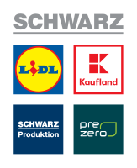












SoftUni Diamond Partners

Slide 77

Educational Partners

Slide 78

License
This course (slides, examples, demos, exercises, homework, documents, videos and other assets) is copyrighted content
Unauthorized copy, reproduction or use is illegal
© SoftUni – https://softuni.org
© Software University – https://softuni.bg
Notes:
78

Slide 79
Trainings @ Software University (SoftUni)
Software University – High-Quality Education, Profession and Job for Software Developers
softuni.bg, softuni.org
Software University Foundation
softuni.foundation
Software University @ Facebook
facebook.com/SoftwareUniversity
Software University Forums
forum.softuni.bg
Notes:
79

